Slide 1
Modern SharePoint Development with React.js
Notes:
This module introduces students to React.js and examines how React.js uses a component-based architecture and a virtual DOM to optimize performance. Students will learn to create and configure new Node.js projects as a Single Page Application (SPA) using React.js together with TypeScript and Webpack. The module walks through how to design an SPA by creating a hierarchy of React components which define properties, state and event handlers. The module introduces JSX and teaches students the essential concepts and syntax for writing TypeScript code in a TSX file to generate the HTML for a React component. Along the way, students will learn how to integrate the React Router into an SPA project to provide navigation across multiple views.

Slide 2
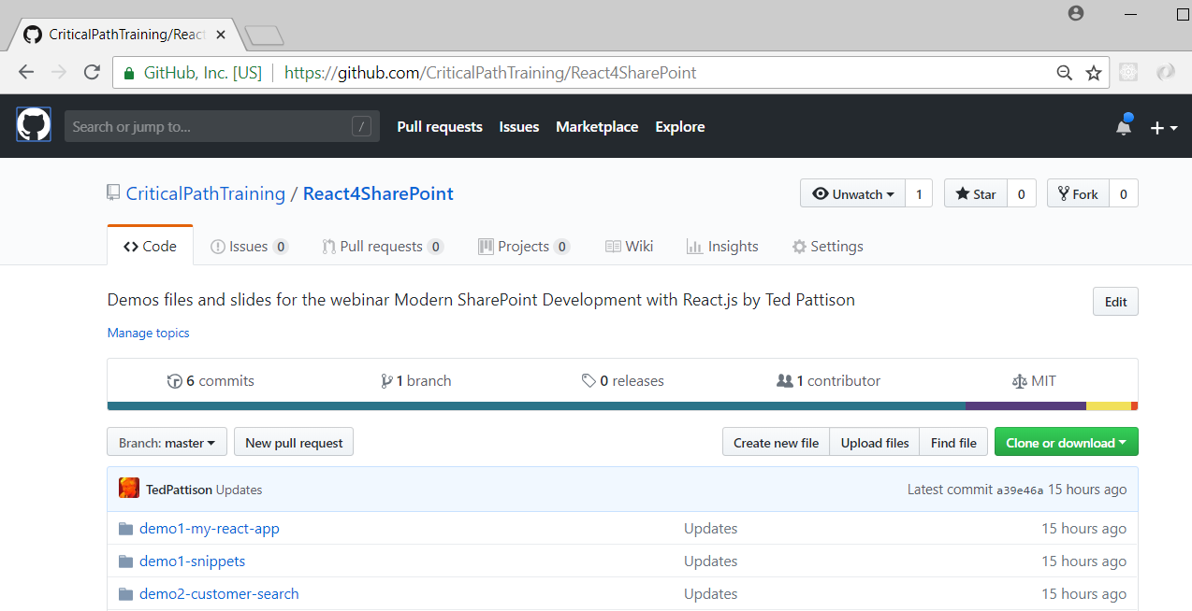
GitHub Repo
All sample code and slides available for download
https://github.com/CriticalPathTraining/React4SharePoint

Slide 3
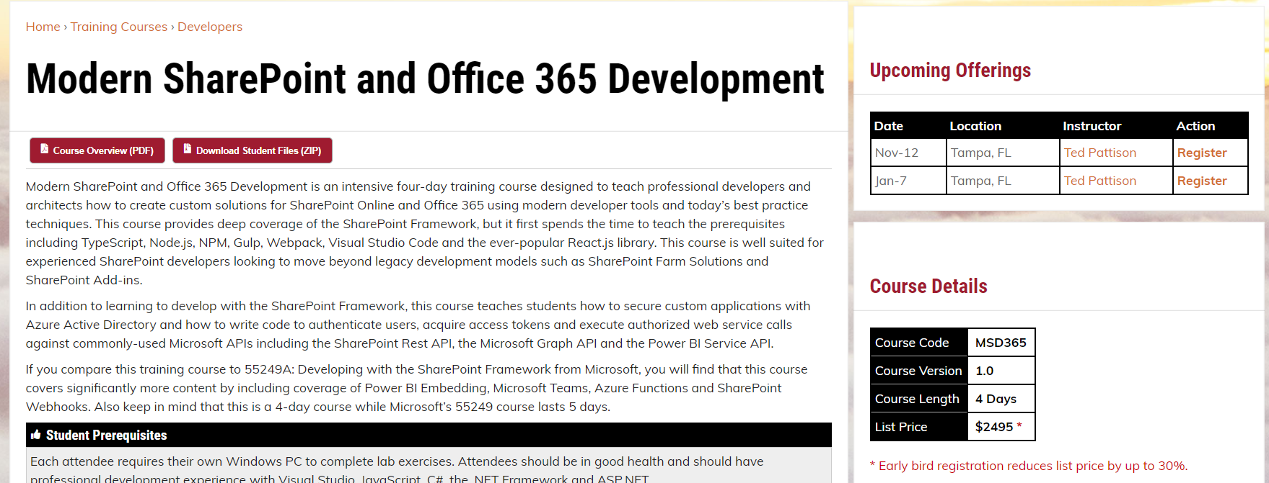
Effective SharePoint Framework Training
MSD365: Modern SharePoint and Office 365 Development
4-day of training with lots of hands-on labs
Learn how to develop with SPFx the right way right from the start
https://www.criticalpathtraining.com/courses/sharepoint/modern-sharepoint-office-365-development/

Slide 4
Agenda
Developing with Node.js, TypeScript and Webpack
Learning React.js Fundamentals
Using the Office UI Fabric React Component Library
Developing React Webparts with SharePoint Framework
Calling the Microsoft Graph API from React Webparts

Slide 5
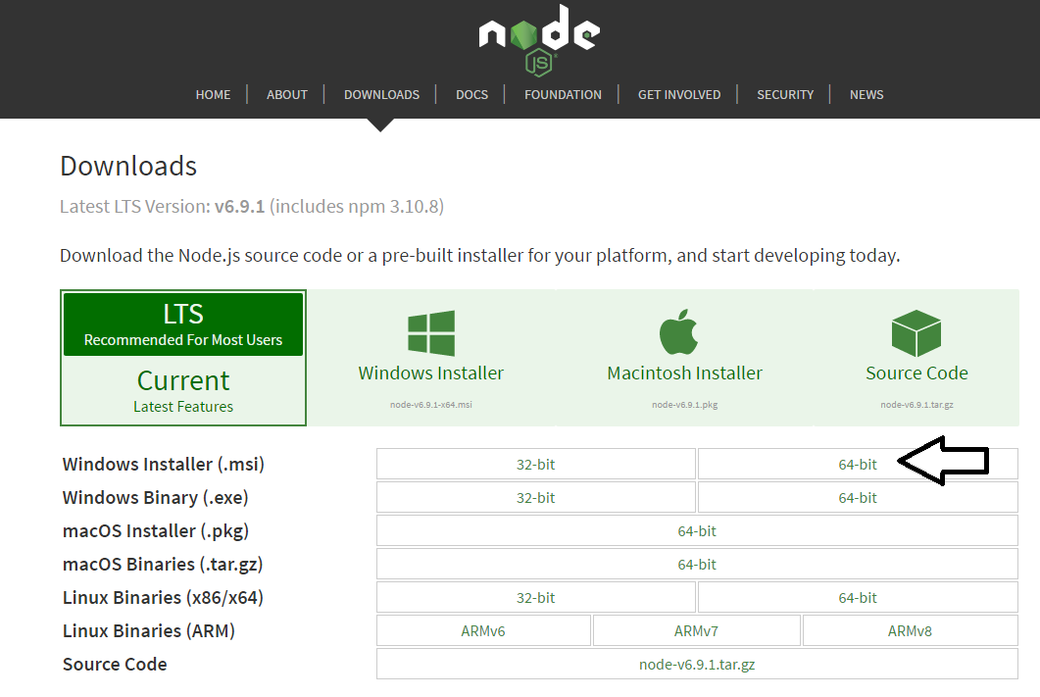
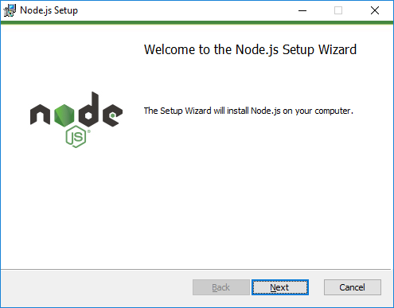
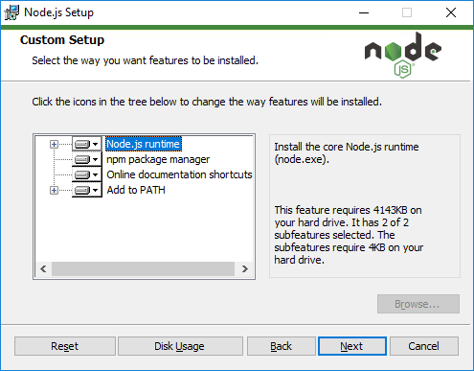
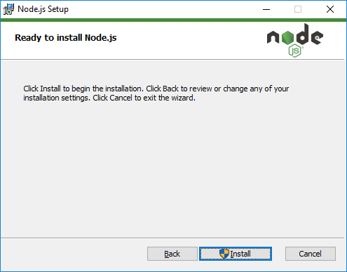
Installing node.js
https://nodejs.org/en/download/

Slide 6
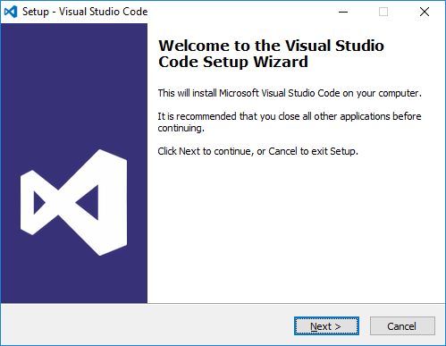
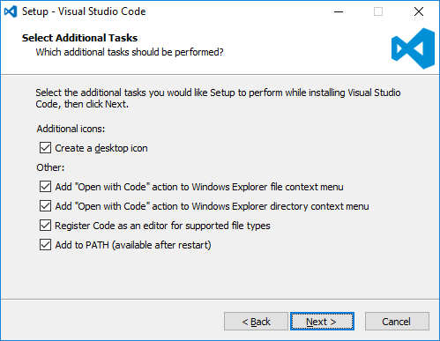
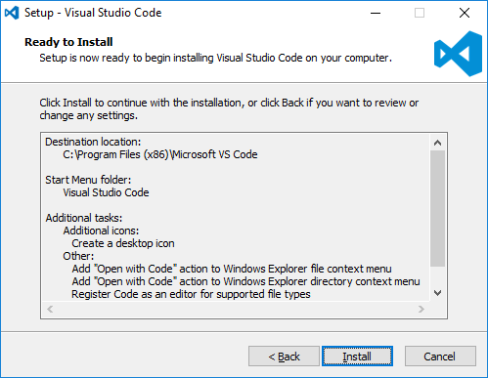
Install Visual Studio Code
http://code.visualstudio.com/

Slide 7
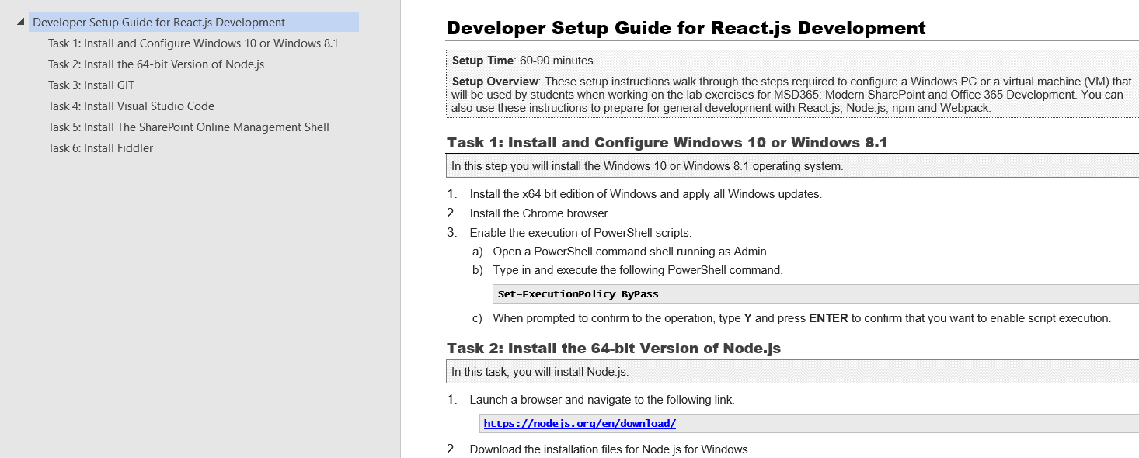
Modern React Developer Setup Guide
Use the Critical Path setup guide to get started
Used to configure Windows PC for react development
https://github.com/CriticalPathTraining/React4SharePoint/raw/master/Setup.pdf

Slide 8
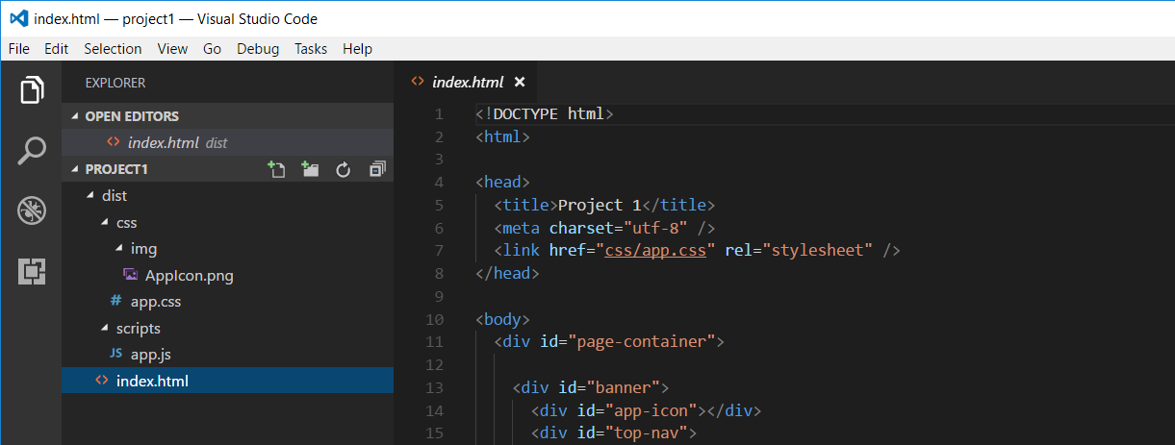
Developing with Visual Studio Code
Node.js is agnostic when it comes to developer IDE
There are many different IDEs that people use with Node.js
This course will be using Visual Studio Code
Visual Studio is not a good fit for Node.js development
Visual Studio solution & project files incompatible with Node.js

Slide 9
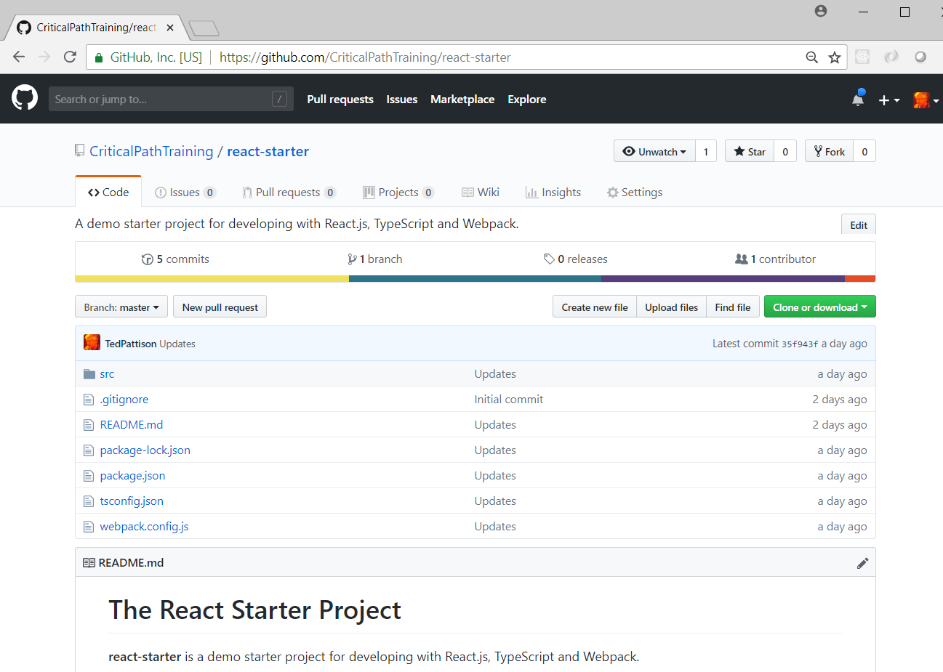
The React Starter Project
https://github.com/CriticalPathTraining/react-starter

Slide 10
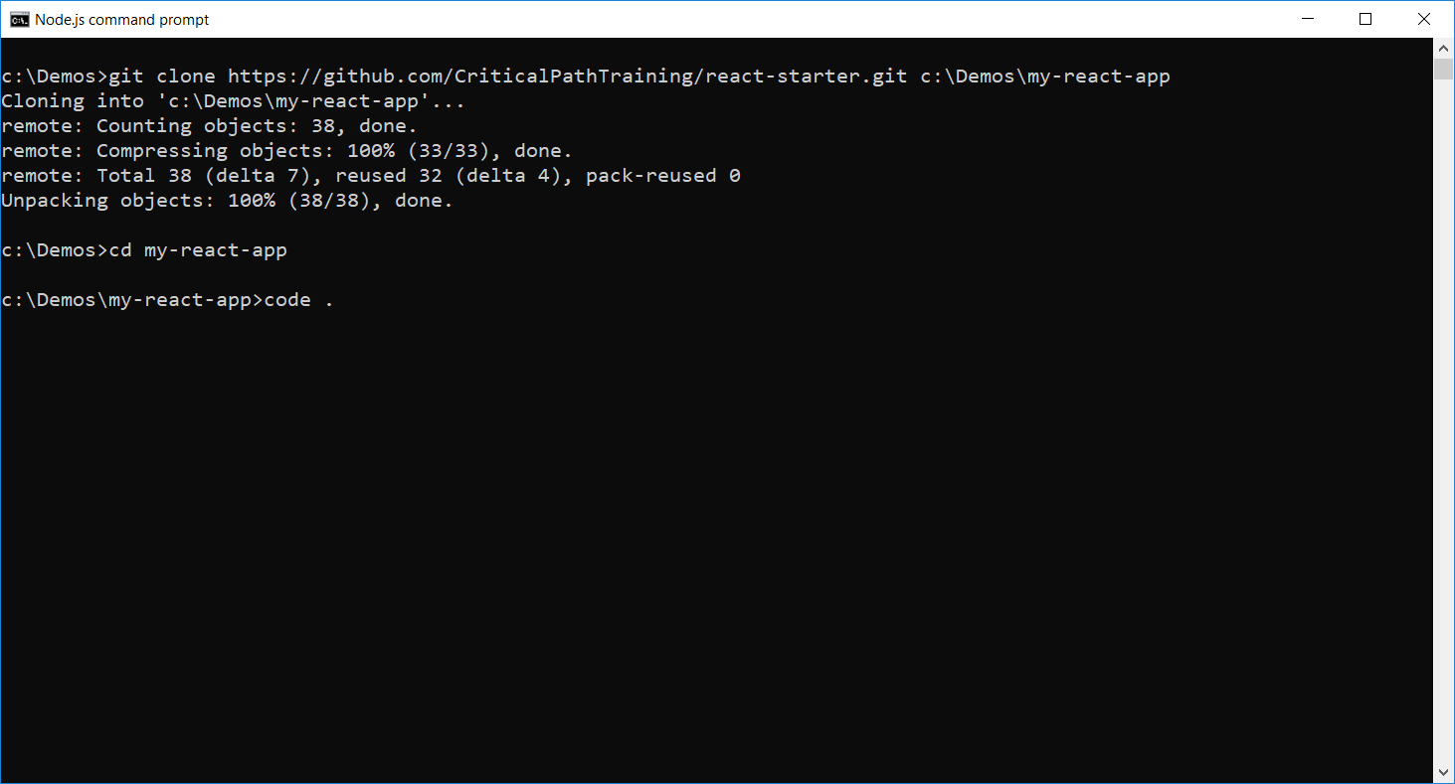
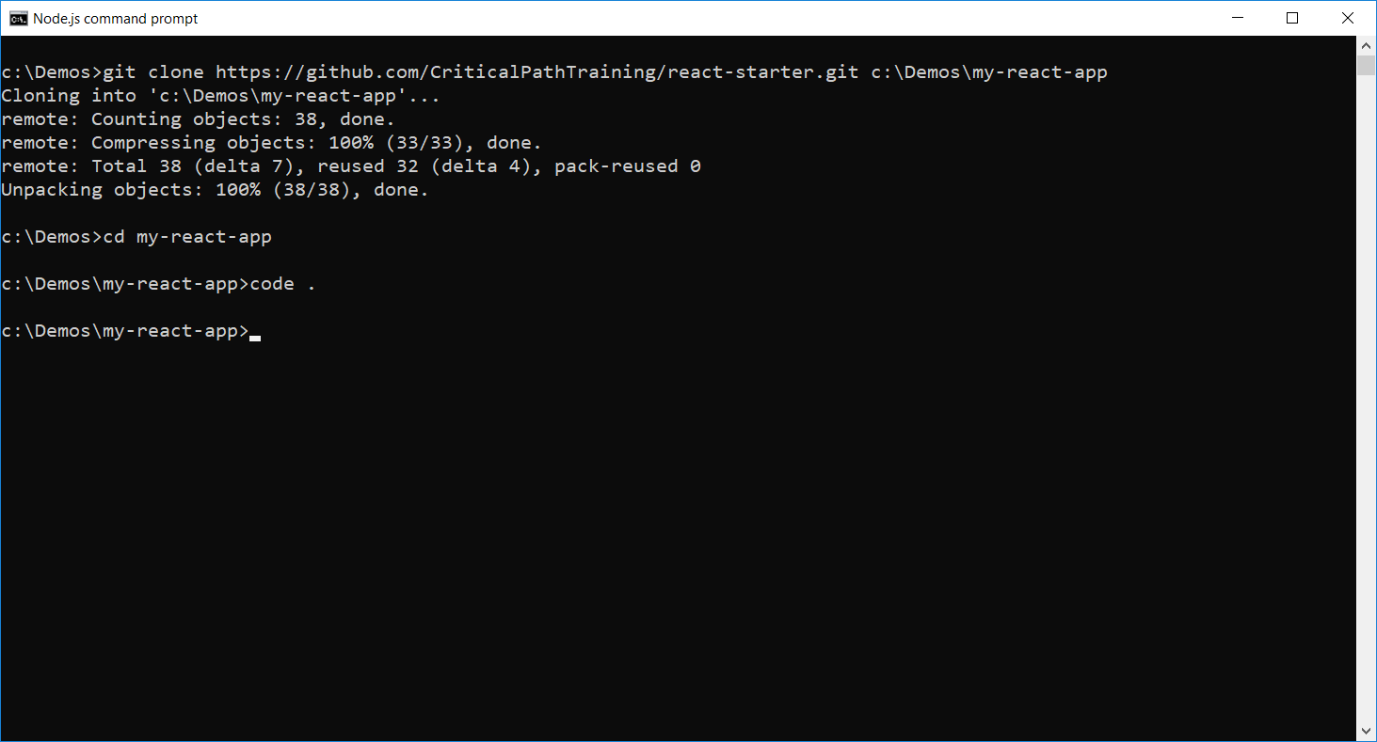
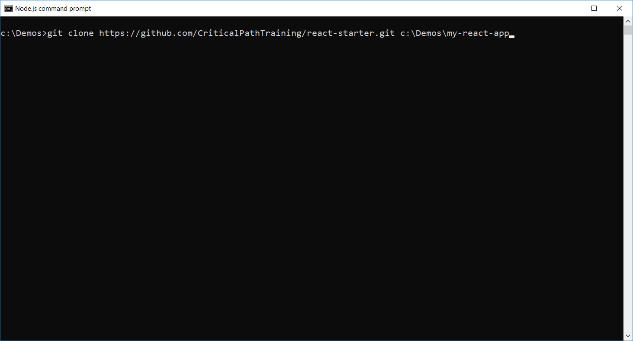
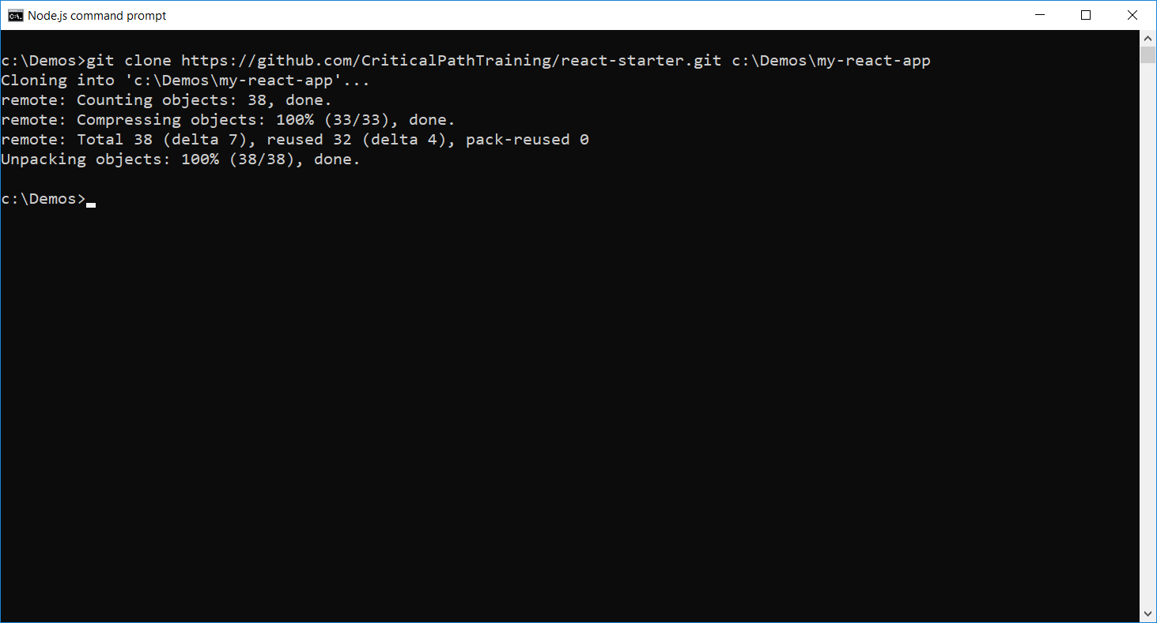
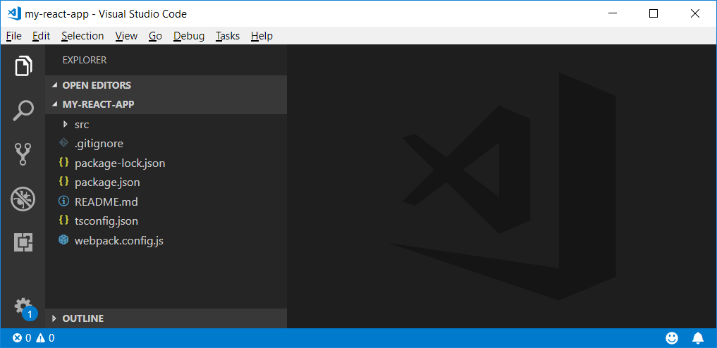
Cloning the Starter Project

Slide 11
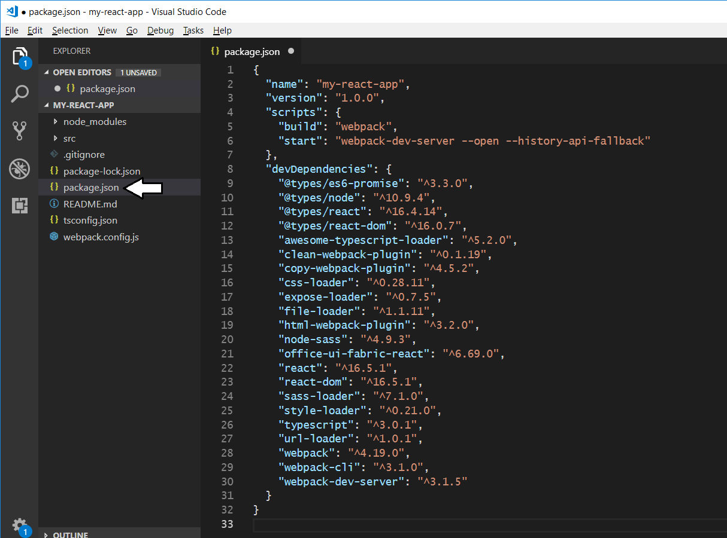
Starter Project - package.json
Rename the project

Slide 12
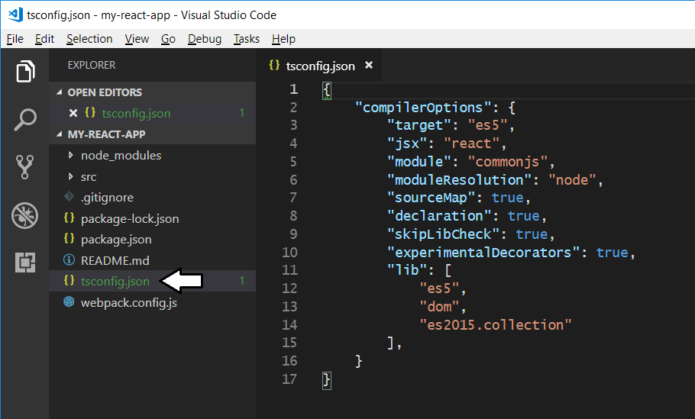
Starter Project tsconfig.json
Dynamic module loading

Slide 13
WebPack
WebPack serves as a bundling utility
Bundles many js/ts files into a single file
Can handle dynamic module loading
Provides a dev server for testing and debugging
When using Webpack 4
Install packages for webpack and webpack-cli
npm install webpack webpack-cli --save-dev

Slide 14
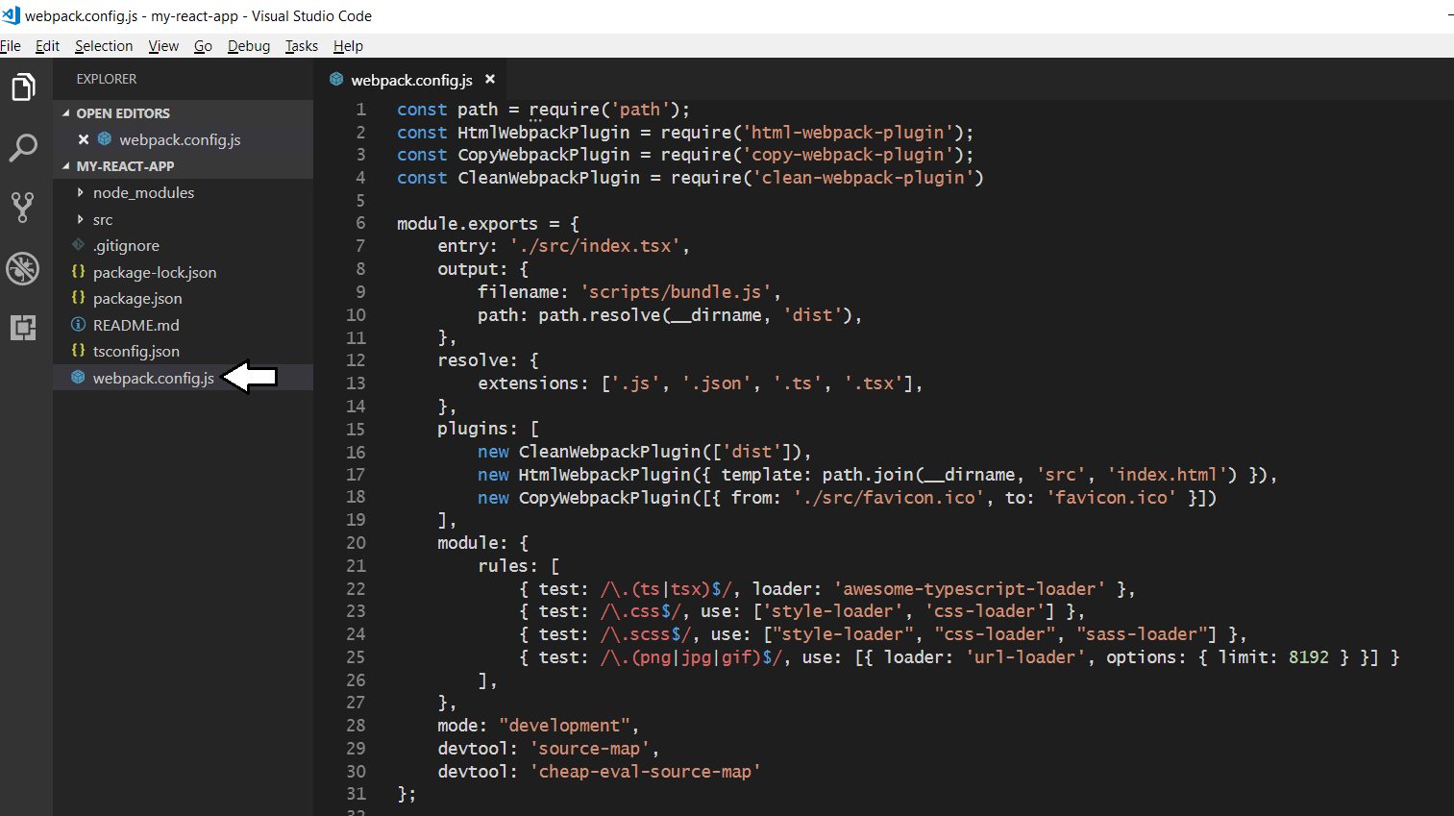
Starter Project - webpack.config.js

Slide 15
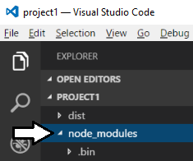
node_modules folder
Package files copied into node_modules folder
This folder often contain 100s of packages for a project
Contents of folder not saved into source control
Contents can be restored with npm install command

Slide 16
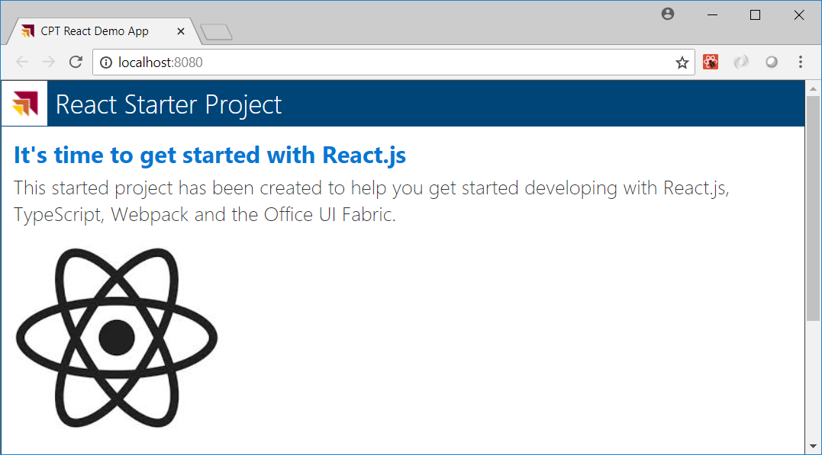
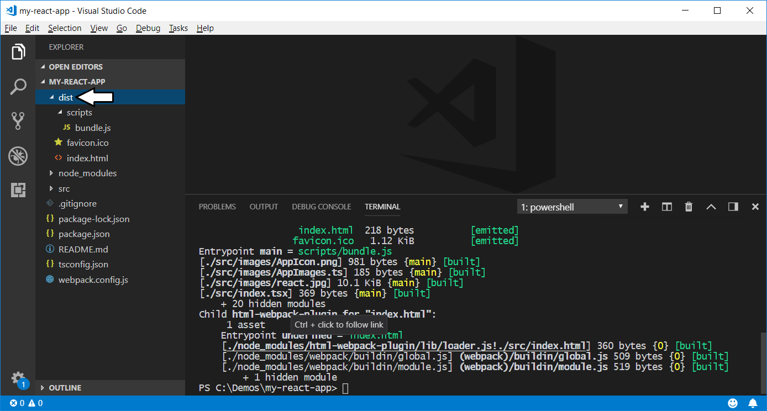
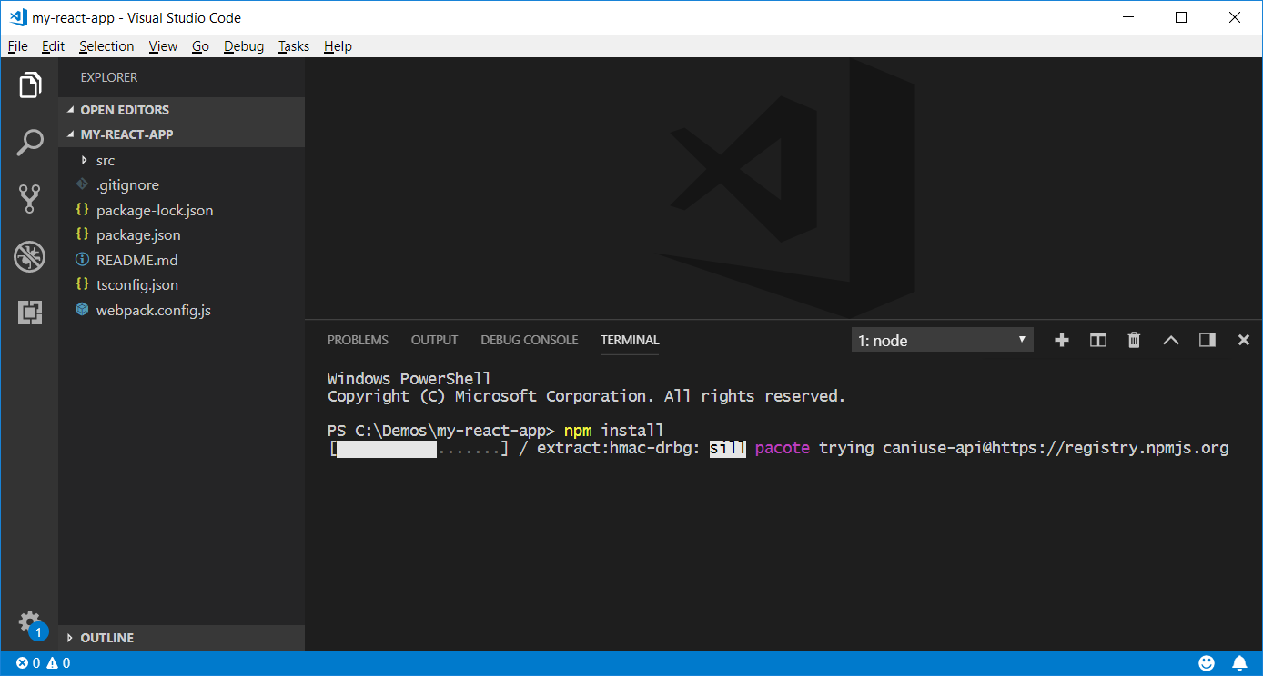
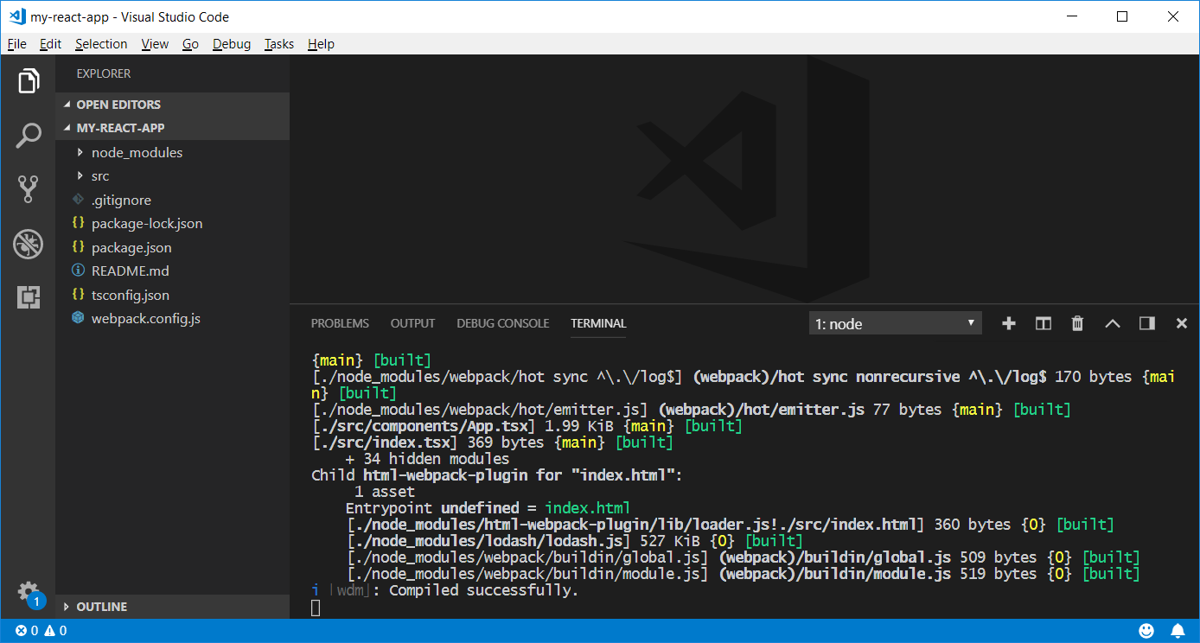
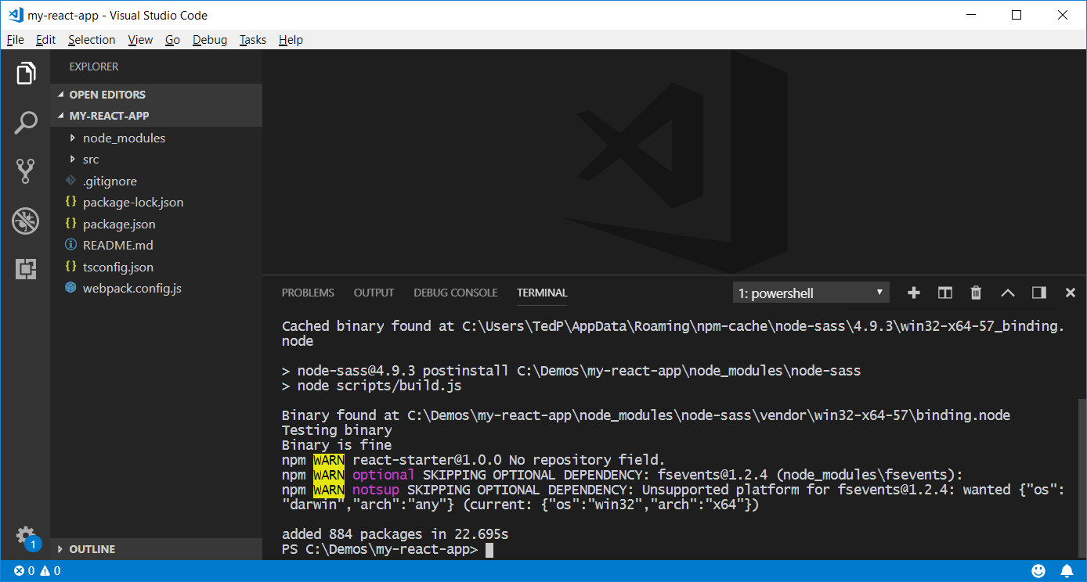
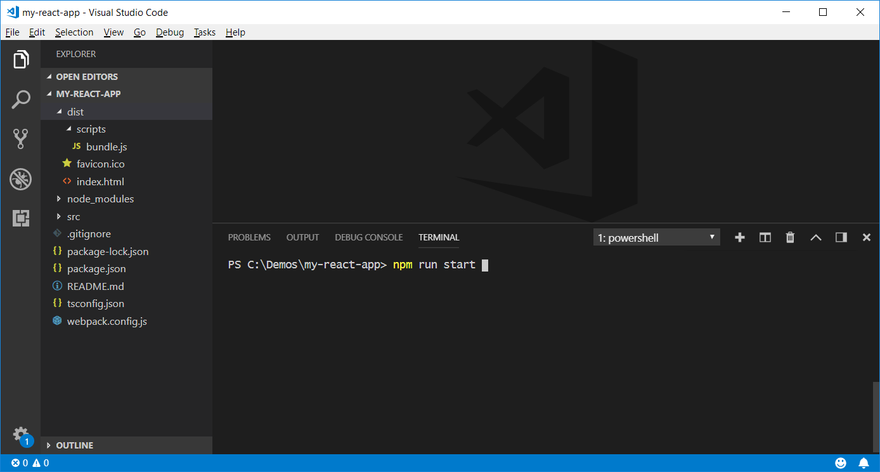
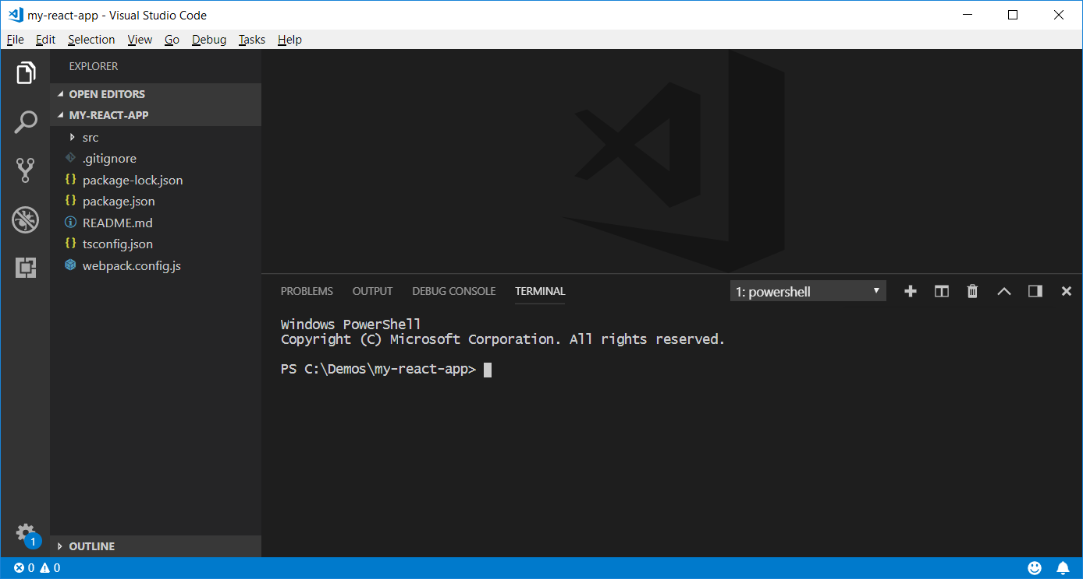
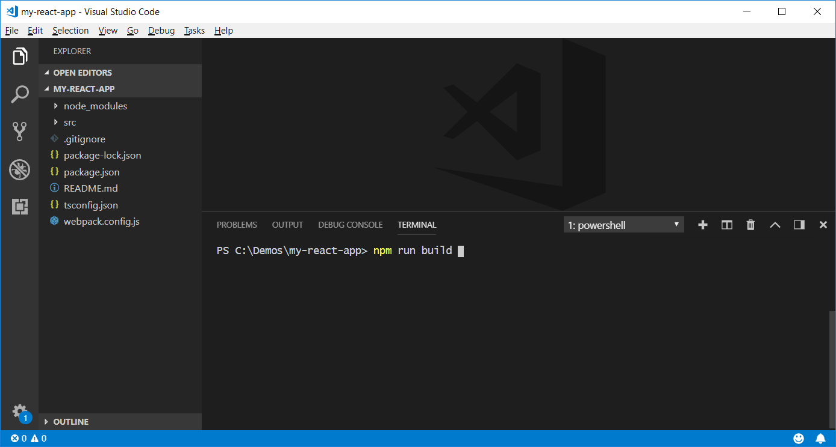
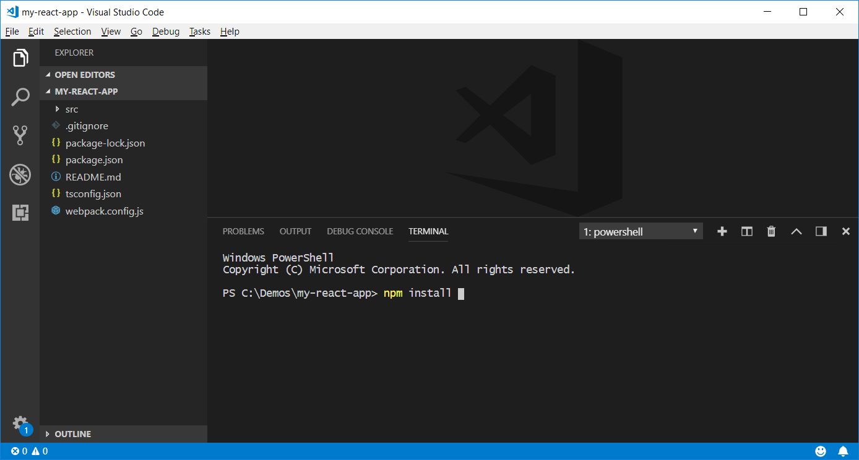
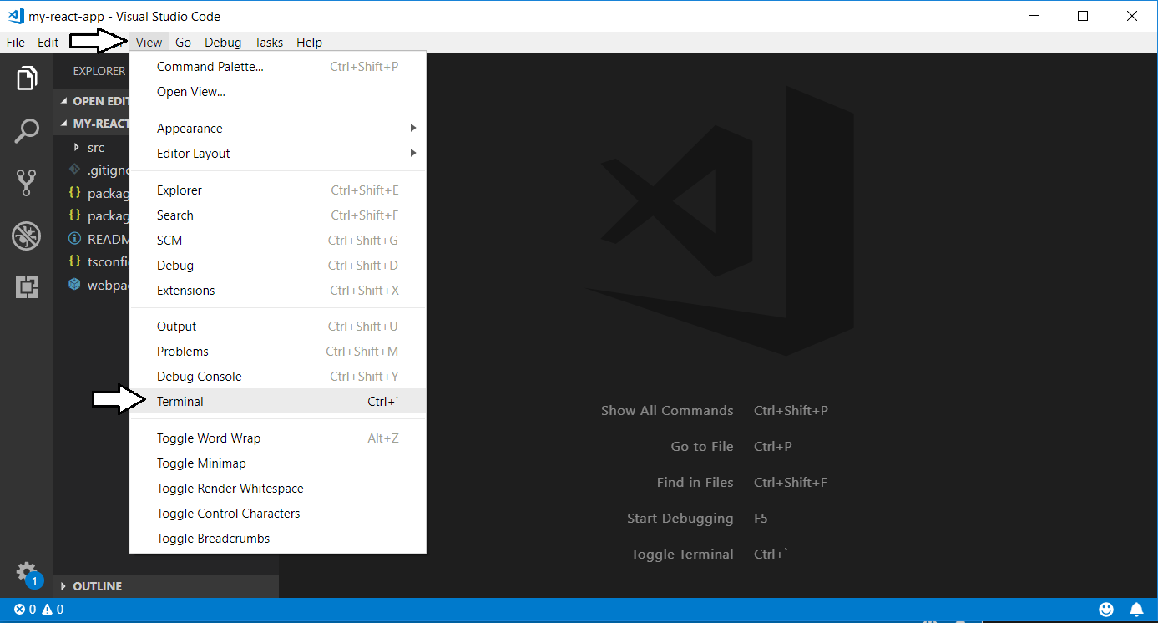
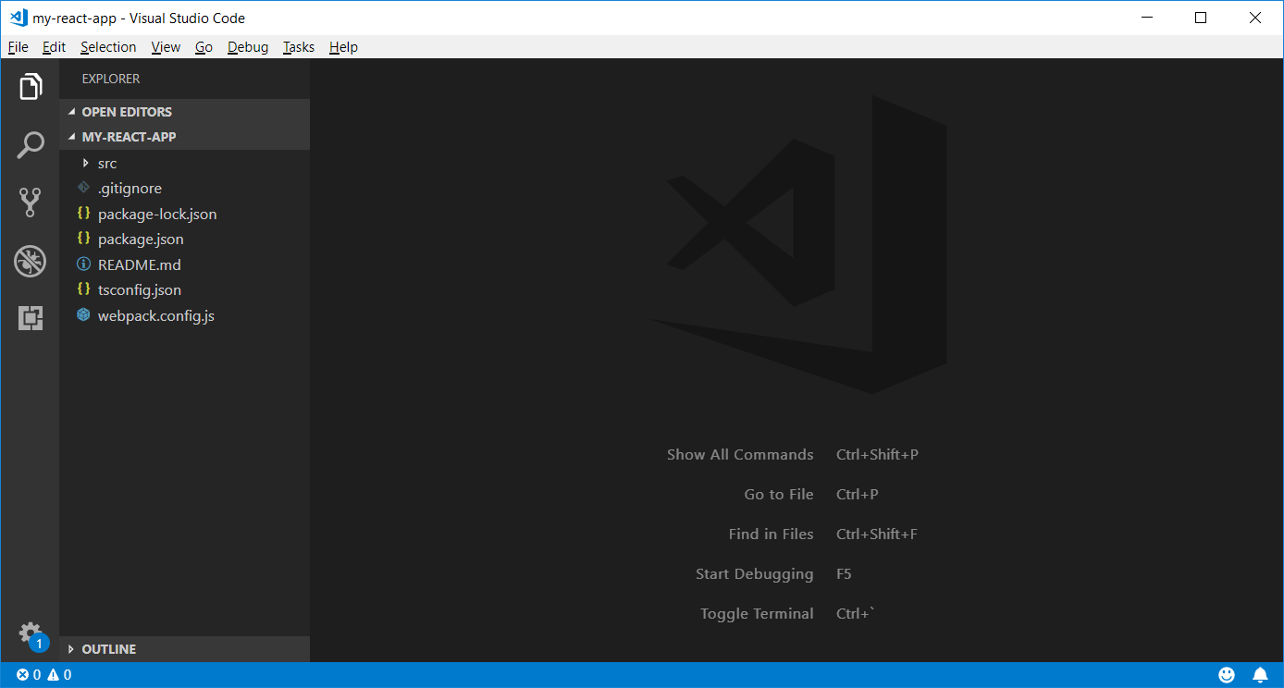
Executing npm Commands in Visual Studio Code

Slide 17
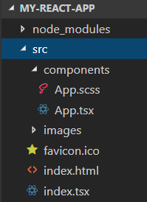
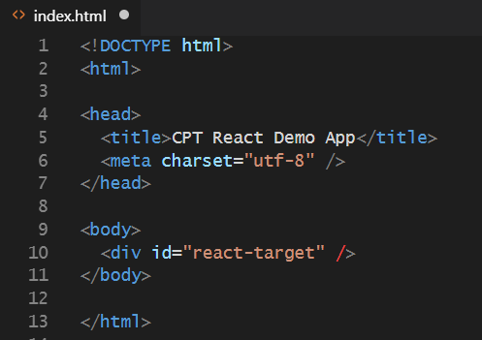
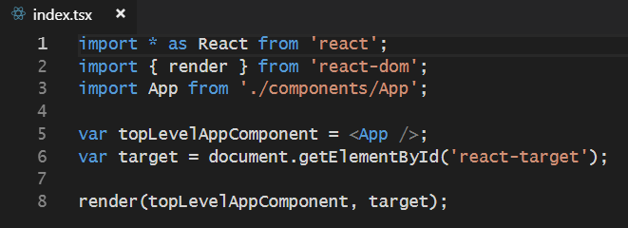
Starter Project Structure

Slide 18
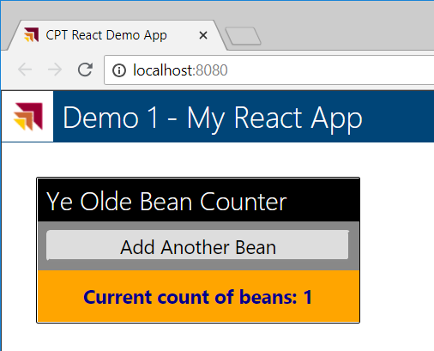
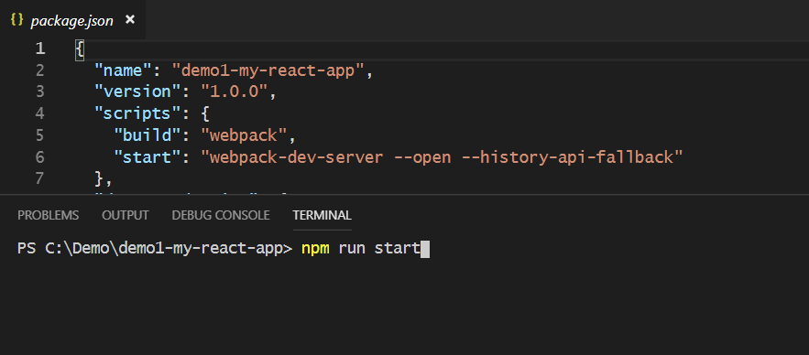
Webpack Dev Server
Webpack provides its own development server
Install the webpack dev server package
npm install webpack-dev-server --save-dev
Run your project using the webpack dev server CLI
webpack-dev-server --open

Slide 19
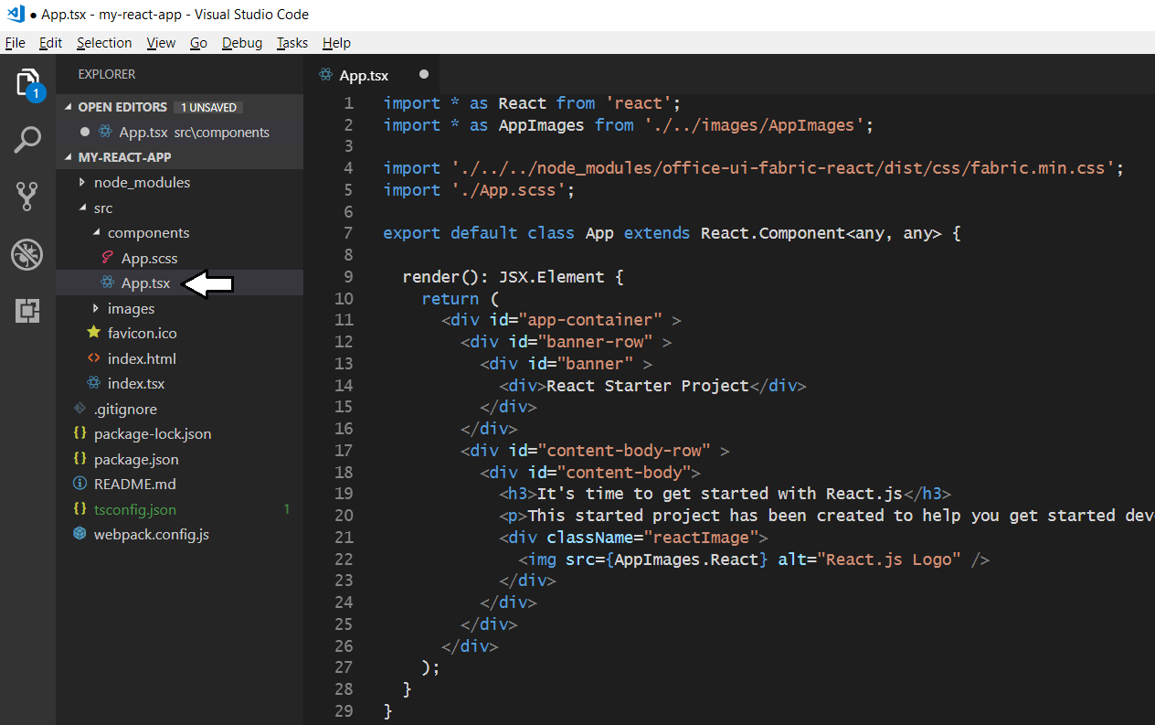
The Top-level App Component

Slide 20
Agenda
Developing with Node.js, TypeScript and Webpack
Learning React.js Fundamentals
Using the Office UI Fabric React Component Library
Developing React Webparts with SharePoint Framework
Calling the Microsoft Graph API from React Webparts

Slide 21
Introducing React
React is a library for building UI experiences
Not as all-encompassing as a framework like Angular
Focused on building HTML-based user experiences
Based on reusable component-based architecture
Components react to state changes by updating UI
React uses shadow DOM for efficient event handling
React was originally designed for Facebook
Also a good fit for building SPFx web parts

Slide 22
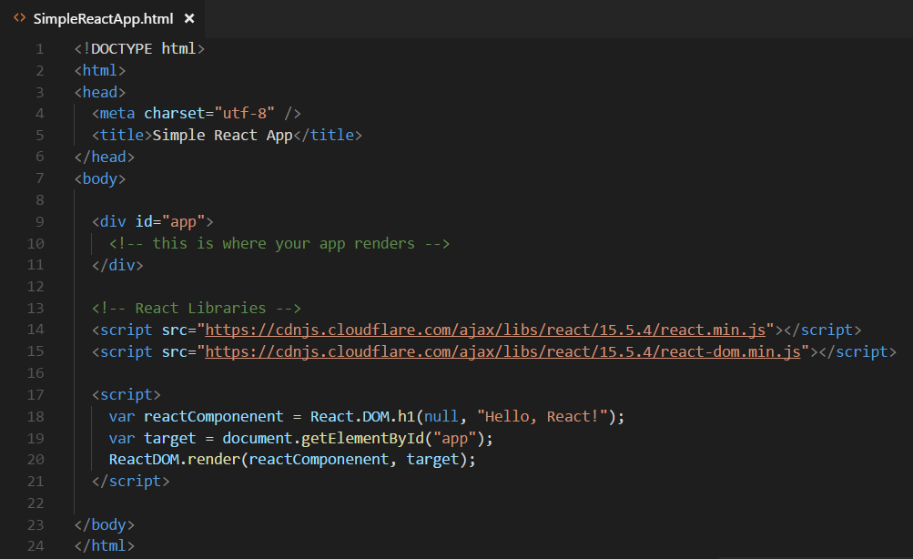
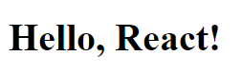
Hello World with React.js and JavaScript
Obtain the React library with npm or from a CDN
npm install react --save
npm install react-dom --save

Slide 23
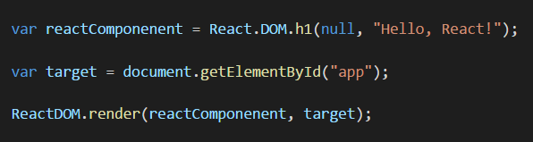
React versus ReactDOM
React and ReactDOM are separate libraries
React (react.js) is the primary library used to build out user experiences
ReactDOM (react-dom.js) is used to render React user experience in the browser
React library exposes global React object
React object is the main entry point into React API
React.DOM wraps standard HTML elements
ReactDOM library exposes global ReactDOM object
ReactDOM object used to render React components on web page

Slide 24
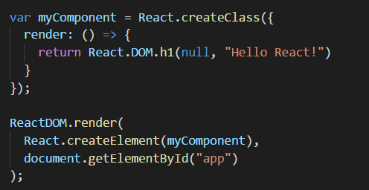
React Component Created Using ES5
React component can be created using EcmaScript 5
React component definition created using React.createClass
React component must be defined with render method
React component can be instantiated with React.createElement

Slide 25
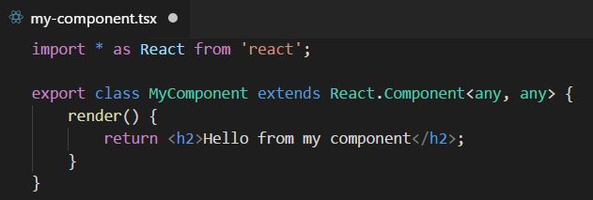
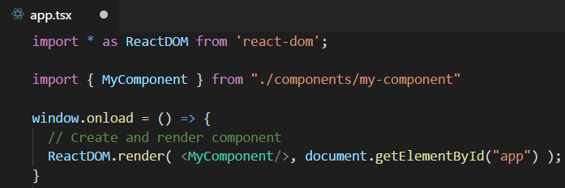
Defining React Components using TypeScript
Component is class extending React.Component
Component usually defined in its own tsx file
Component class must define render method
Component can be instantiated with JSX/TSX syntax

Slide 26
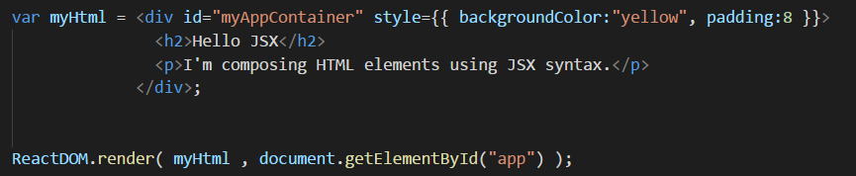
Understanding JSX (and TSX)
JSX provides better syntax for HTML composition
JSX allows extends JavaScript with XML-like syntax
JSX syntax must be transpiled into JavaScript code
JSX/TSX is separate from React library
JSX/TSX commonly used in React development
Babel compiler used to transpile JSX to JavaScript
TypeScript compiler used to transpile TSX to JavaScript

Slide 27
Component Properties and State
Component can contain properties and state
Properties are initialized by external components
Properties are read-only to hosting component
State is set internally by hosting component
Changing state triggers UI refresh by calling render
UI experience created by reacting to changes in state

Slide 28
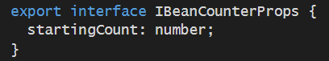
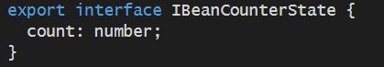
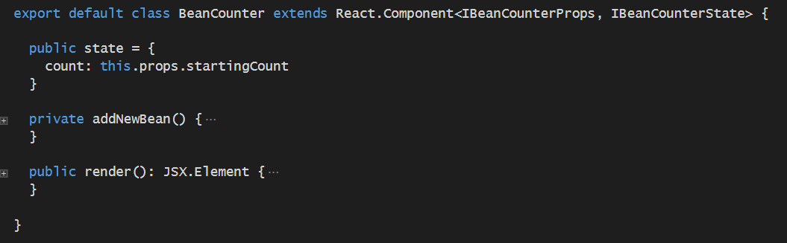
Designing with Properties and State

Slide 29
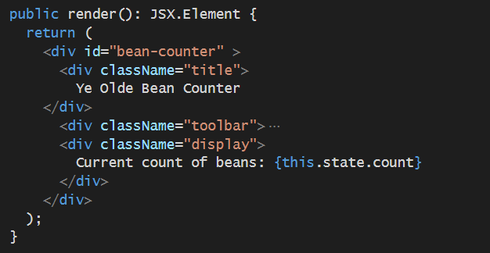
Component Rendering using State
render method implemented using state
render method executes whenever state is updated

Slide 30
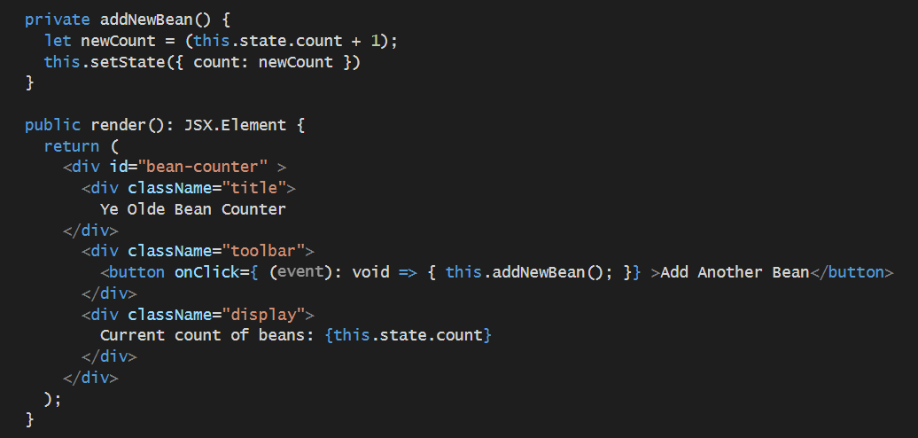
React Provides Synthetic Events
Replaces standard DOM-based event handling
React creates virtual DOM for elements created by component
Provides high-performant code in busy web pages

Slide 31

Demo 1 - Creating a Simple React Component

Slide 32

React Component Hierarchies
App
Banner
Topnav
MainView

Slide 33

Demo 2 - Customer Search

Slide 34

React Router
Used to create route map in single page application (SPA)
Installed as a pair of npm packages
npm install react-router @types/react-router --save-dev
npm install react-router-dom @types/react-router-dom --save-dev
Router must be added in as top-level component above App

Slide 35


Using React Router
Import Route and Switch components
Create route map in HTML output

Slide 36


Creating Route Links

Slide 37
Component Lifecycle
componentWillUpdate
executed before component is rendered
componentDidUpdate
executed after component is rendered
componentWillMount
executed before node is added to the DOM
componentDidMount
executed after node is added to the DOM
componentWillUnmount
executed before node is removed from the DOM
shouldComponentUpdate(newProps, newState)
executed before component is updated

Slide 38



Defining Interfaces for Data Access Code

Slide 39


Calling a Web Service using the Fetch API

Slide 40
Agenda
Developing with Node.js, TypeScript and Webpack
Learning React.js Fundamentals
Using the Office UI Fabric React Component Library
Developing React Webparts with SharePoint Framework
Calling the Microsoft Graph API from React Webparts

Slide 41


What is the Office UI Fabric?
Office UI Fabric is responsive, mobile-first, front-end style framework
Built by Microsoft to style Office 365, OneDrive and SharePoint sites
All about styling instead of JavaScript
Can be used by 3rd party developers
Fabric Core
Fabric React
Fabric JS
ngFabric
Fabric iOS
Core elements of the design language including icons, colors, type, and the grid
Robust, up-to-date components built with the React framework.
Simple, visuals-focused components that you can extend, rework, and build on.
Community-driven project to build components for Angular-based apps.
Native Swift colors, type ramp, and components for building iOS apps.

Slide 42

Responsive Grid
Fabric comes with a mobile-first, responsive grid
Based on 12 column grid
Used to create flexible layouts
<div class="ms-Grid">
<div class="ms-Grid-row">
<div class="ms-Grid-col ms-u-sm6 ms-u-md4 ms-u-lg2">First</div>
<div class="ms-Grid-col ms-u-sm6 ms-u-md8 ms-u-lg10">Second</div>
</div>
</div>

Slide 43

Demo 3 - Office UI Fabric

Slide 44





Fabric Core styling
Fonts and typography
Segoe font family + type ramp
Official Office 365 iconography
Color
Official Office 365 color palette
Branded assets
Product symbols + product filetype symbols
Animations
Official Office 365 selection of easings and animations
Responsive grid
Tailored to Office 365 silhouettes

Slide 45

Typography
Base font classes
Fabric includes 10 base font classes
Each base class sets a default size, weight, and color.

Slide 46

Typography
Helper font classes
There are helper font classes to change the text weight.

Slide 47

Putting Office UI Fabric Styles to Use

Slide 48

Office UI Fabric React Component Library
https://developer.microsoft.com/en-us/fabric#/components

Slide 49

Using Persona Cards

Slide 50



Adding a Persona Component

Slide 51



Using the DetailsList Component

Slide 52


React Developer Tools - Chrome Extension

Slide 53
Agenda
Developing with Node.js, TypeScript and Webpack
Learning React.js Fundamentals
Using the Office UI Fabric React Component Library
Developing React Webparts with SharePoint Framework
Calling the Microsoft Graph API from React Webparts

Slide 54

Creating a React Webpart
You can select React as framework for your webpart
You can create a React webpart when creating new project
You can add React webpart to existing project
React webpart made up of several different source files
React component SCSS module
React component class
React component properties interface
Webpart manifest
Webpart class

Slide 55



React Webpart Architecture
Webpart class instance
React component instance
React.CreateElement
description

Slide 56


React Webpart Styling

Slide 57


Webpart Persistent Properties
Persistent properties defined in webpart using interface
Property default values add to webpart manifest
LeadTrackerWebPart
Webpart instance
persistent
properties

Slide 58




Designing the React Component
LeadTracker
React component

Slide 59

Referencing the React Component Instance
LeadTrackerWebPart
Webpart instance
LeadTracker
React instance
leadTracker

Slide 60



Synchronizing React State with Webpart Properties
Automatic updates
LeadTrackerWebPart
Webpart instance
LeadTracker
React instance
React.Component.setState
targetList

Slide 61

Demo 4 - The Lead Tracker React Webpart

Slide 62

Calling to the SharePoint Rest API

Slide 63
Agenda
Developing with Node.js, TypeScript and Webpack
Learning React.js Fundamentals
Using the Office UI Fabric React Component Library
Developing React Webparts with SharePoint Framework
Calling the Microsoft Graph API from React Webparts

Slide 64
SPFx Includes Microsoft Graph Client
SharePoint Online already has an Azure AD application
SPFX solutions can call SharePoint REST API in the same domain
No extra authentication required
What about calling Microsoft Graph API across domains?
SPFX provides proxy to call Microsoft Graph API
MSGraphClient is the new Microsoft Graph Client for SPFx
Moved out of preview to release with API v1.6
Abstracts the token acquisition from the SPFx development

Slide 65

SPFx Solutions Declare Permission Requests
Used to request tenant-wide permissions
Permissions must be granted by tenant adminsitrator

Slide 66

Add Package to SharePoint App Catalog
Extra note in dialog notifies of additional step required
While application can be installed in SharePoint sites, it does not have the permissions granted that it needs to access Azure AD protected resources

Slide 67


Approve / Reject with SharePoint Online API Management Page

Slide 68

Demo 5 - Calling Microsoft Graph API

Slide 69

Acquiring the MSGraphClient from WebPart

Slide 70

Microsoft Graph TypeScript Type Declarations
Use the Microsoft Graph JavaScript SDK in TypeScript applications
TypeScript type declarations introduce strong types
https://github.com/microsoftgraph/msgraph-typescript-typings

Slide 71

Service Class using Microsoft Graph API

Slide 72
Effective SharePoint Framework Training
MSD365: Modern SharePoint and Office 365 Development
4-day of training with lots of hands-on labs
Learn how to develop with SPFx the right way right from the start
https://www.criticalpathtraining.com/courses/sharepoint/modern-sharepoint-office-365-development/

Slide 73
Summary
Developing with Node.js, TypeScript and Webpack
Learning React.js Fundamentals
Using the Office UI Fabric React Component Library
Developing React Webparts with SharePoint Framework
Calling the Microsoft Graph API from React Webparts

